Slide 1

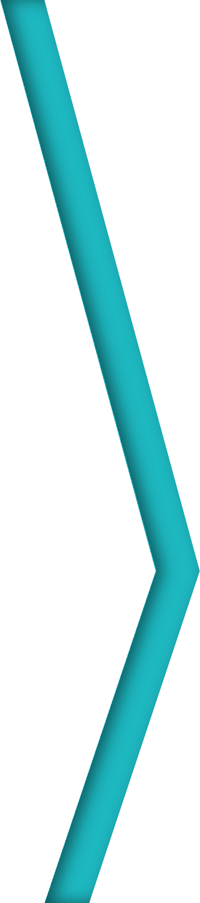

Session 2
Working with ASP.NET Web
Forms, Controls, and Events
For Aptech Centre Use Only

Slide 2
Session Overview
EebxpalpapinlicWation development and Web Forms
Describe event handling in ASP.NET
List and describe various types of controls in ASP.NET
For Aptech Centre Use Only

Slide 3
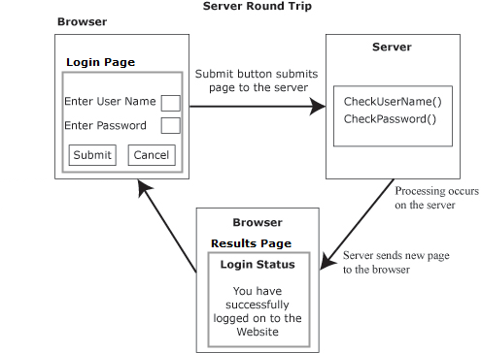
Web Application Development and Web Forms (1-2)
A Web application is a computer program consisting of HTML Pages with contents and hyperlinks (URL).
It resides on a remote server and passed over the network such as a browser application.
ASP.NET is an advanced technology enabling a fast Web development with lesser code.
ASP.NET offers three programming models for creating Websites - Web Forms, Web Pages, and Model-View- Controller (MVC) Applications.
For Aptech Centre Use Only

Slide 4
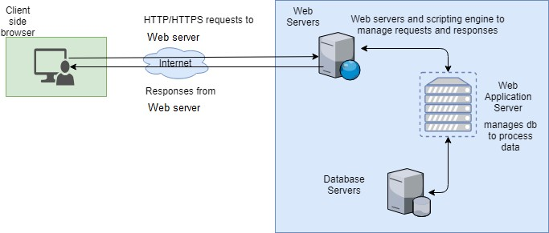
Web Application Development and Web Forms (2-2)
For Aptech Centre Use Only
Web Application Process

Slide 5
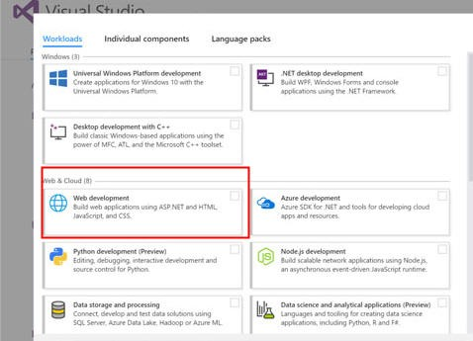
ASP.NET Environment Setup
Microsoft Visual Studio is an exceptionally capable IDE for writing, compiling, and debugging code.
Selecting Workloads for Web Development
Provides a complete set of development tools for building ASP.NET Web applications, Web services, desktop applications, and mobile applications.
While installing it, one must select appropriate workloads so as to ensure correct templates.
For Aptech Centre Use Only

Slide 6
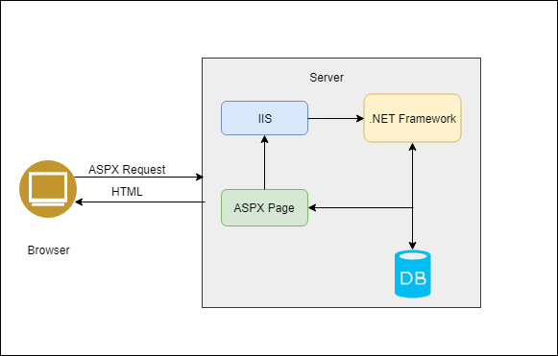
ASP.NET Web Forms
ASPX
Is a visual based Web page or User Interface (UI).
Code-behind file
Contains server-side code of the Web page specifying how the Web page and its visual controls should behave upon execution.
For Aptech Centre Use Only
Processing of ASP.NET Web Form
Web Forms Page Segments

Slide 7
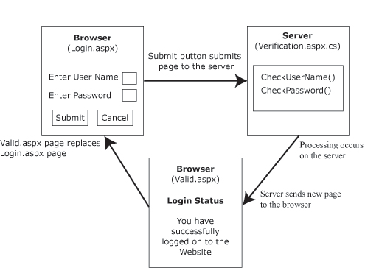
ASP.NET Web Forms - Example
For Aptech Centre Use Only

Slide 8
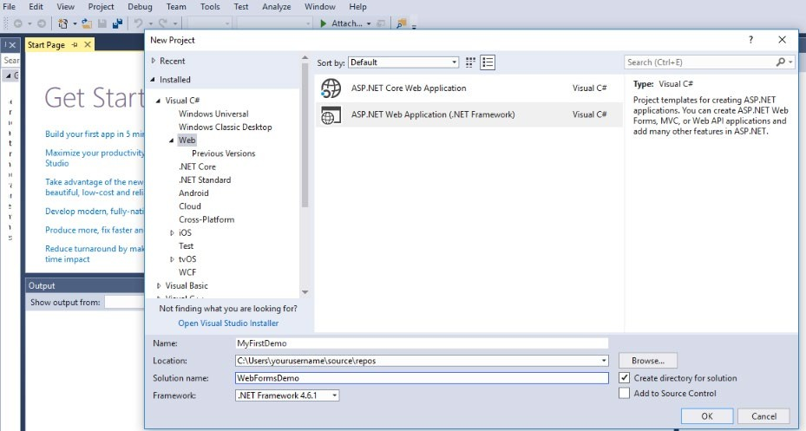
Creating an ASP.NET Web Form (1-6)
For Aptech Centre Use Only
Creating a New Project

Slide 9
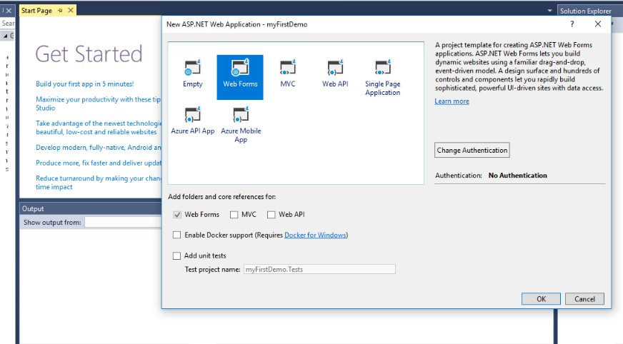
Creating an ASP.NET Web Form (2-6)
For Aptech Centre Use Only
Selecting a Web Form

Slide 10
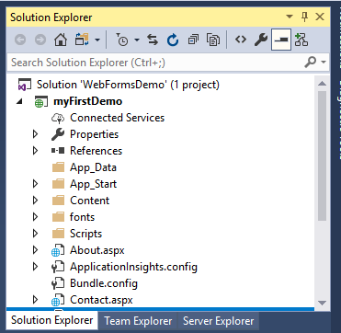
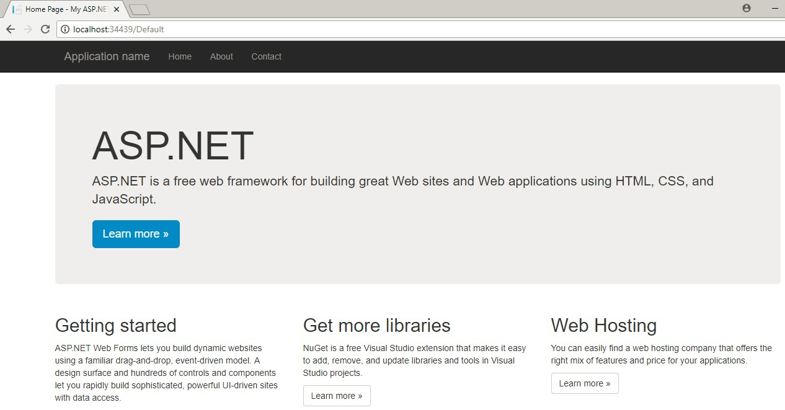
Creating an ASP.NET Web Form (3-6)
For Aptech Centre Use Only
Solution Explorer
Default .ASPX Page

Slide 11
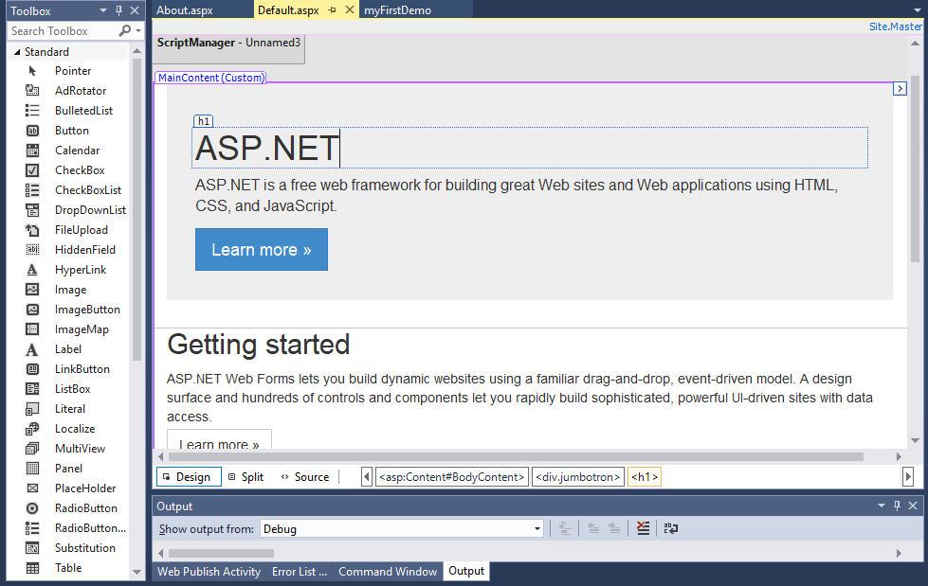
Creating an ASP.NET Web Form (4-6)
For Aptech Centre Use Only
Design Output

Slide 12
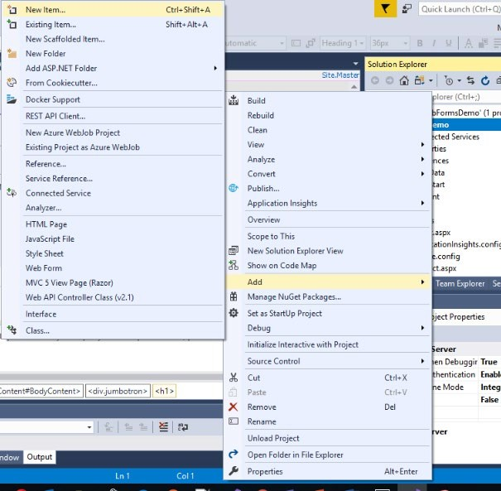
Creating an ASP.NET Web Form (5-6)
For Aptech Centre Use Only
Adding a New Item

Slide 13
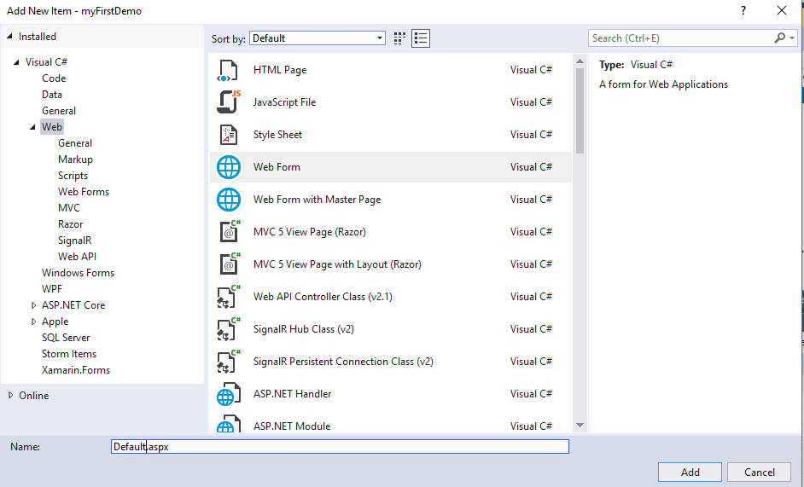
Creating an ASP.NET Web Form (6-6)
For Aptech Centre Use Only
Selecting Web Form

Slide 14
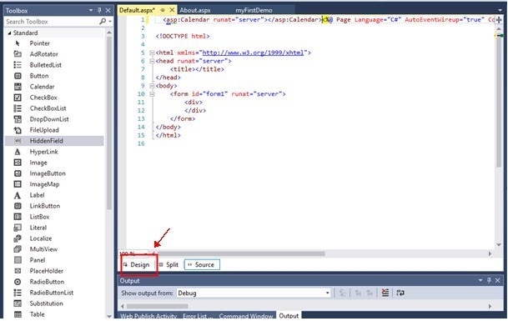
Adding Controls to the Form (1-3)
For Aptech Centre Use Only
Design Tab

Slide 15
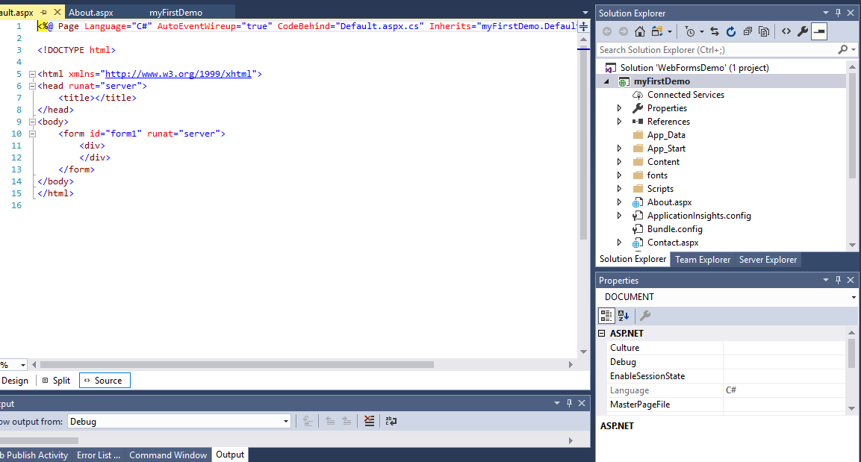
Adding Controls to the Form (2-3)
For Aptech Centre Use Only
Selecting a Control

Slide 16
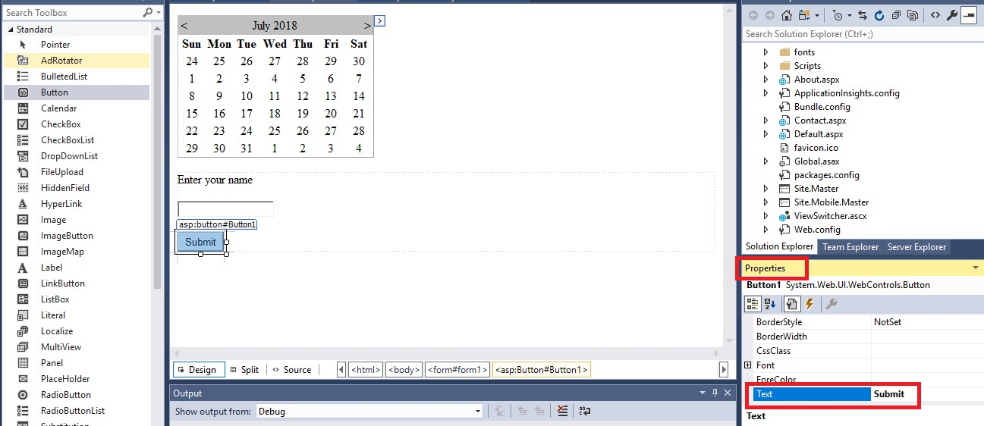
Adding Controls to the Form (3-3)
For Aptech Centre Use Only
Creating a Web Form

Slide 17
Controls in ASP.NET
HTML Server Controls - Traditional HTML tags
For Aptech Centre Use Only
Web Server Controls - ASP.NET tags
Validation Server Controls - For input validation

Slide 18
HTML Server Controls (1-4)
Advantages of HTML Server Controls over HTML Elements:
Compiled into the assembly with the runat="server" attribute
Map to the corresponding HTML tags
Retain their values, whenever ASP.NET page is reloaded
OnserverEvent is included in most controls for commonly used events
For Aptech Centre Use Only

Slide 19
HTML Server Controls (2-4)
Control Name HTML Tag with Description
HtmlHead
<head>element
Used to store page Title and CSS, JavaScript links.
HtmlInputButton
<input type = button|submit|reset> Similar to HTML Submit Button.
HtmlInputCheck
<input type = checkbox>
Used to Check/Uncheck multiple options.
For Aptech Centre Use Only
HtmlInputFile
<input type = file>
Used to browse and upload files.
HtmlInputHidden
<input type = hidden>
Used to store temporary value.
HtmlInputImage
<input type = image>
Used to load and display image.
HTML Server Controls

Slide 20
HTML Server Controls (3-4)
Control Name HTML Tag with Description
HtmlInputpassword
<input type = password>
Textbox that masks password to *.
HtmlInputRadioButton
<input type = radio>
Used to select single option from multiple options.
HtmlInputreset
<input type = reset> HTML Form reset button.
For Aptech Centre Use Only
HtmlText
<input type = Text> Similar to HTML textbox.
HtmlImage
<img> element
Used to display image.
HtmlLink
<link> element
Similar to HTML hyperlink.
HTML Server Controls

Slide 21
HTML Server Controls (4-4)
Control Name
HTML Tag with Description
HtmlAnchor
<a> element
Similar to HTML hyperlink.
HtmlButton
<button> element Similar to HTML button.
For Aptech Centre Use Only
HtmlForm
<form> element
HTML form used to add input controls.
HtmlTable
<table> element
HTML table to show data/control in tabular format.
HTML Server Controls

Slide 22
Web Server Controls
Web Server Control | Description
AdRotator | Displays a sequence of images.
Button | Displays a push button.
Calendar | Displays a calendar.
CheckBox | Displays a check box.
CheckBoxList | Creates a multi-selection check box group.
DataGrid | Displays fields of a data source in a grid.
DataList | Displays items from a data source by using templates.
Image | Displays an image.
ImageButton | Displays a clickable image.
Label | Displays static text that displays information as a response to an action or description of how a control will behave when clicked.
ListBox | Creates a single or multi-selection drop-down list.
Table | Creates a table.
For Aptech Centre Use Only
© Aptech Limited Programming for the Web with ASP.NET MVC/Session 2
Web Server Controls
22

Slide 23
ASP.NET Validation Server Controls (1-2)
 | Validation Server Control | Description
 | CompareValidator | Compares the value of one input control to the value of another input control or to a fixed value.
 | CustomValidator | Allows writing a method to handle the validation of the value entered.
 | RangeValidator | Checks that the user enters a value that falls between two values.
 | RegularExpressionValidator | Ensures that the value of an input control matches a specified pattern.
 | RequiredFieldValidator | Makes an input control a required field.
 | ValidationSummary | Displays a report of all validation errors that occurred in a Web page.
Syntax <asp:control_name id="some_id" runat="server" />
For Aptech Centre Use Only
Validation Server Controls

Slide 24
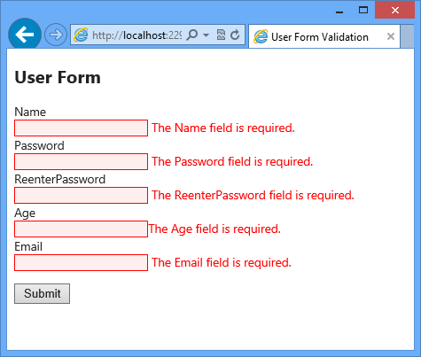
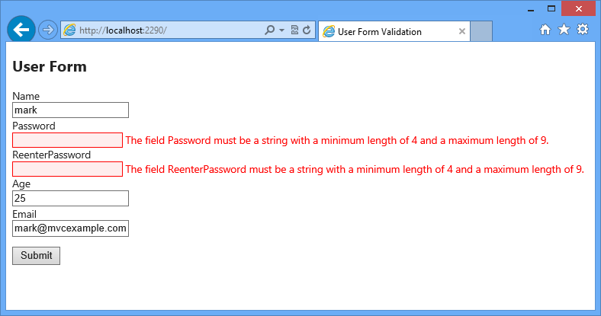
ASP.NET Validation Server Controls (2-2)
For Aptech Centre Use Only
Validation Server Controls

Slide 25
Event Handling in ASP.NET (1-4)
Sequence of steps while handling Button Click event are:
User clicks a Button in the client (Browser)
Click event is raised by the application
Browser publishes this event to the server
The event handler is executed by server
Notifications generated by the system to the user (Browser)
For Aptech Centre Use Only

Slide 26
Event Handling in ASP.NET (2-4)
Application and Session Events
Application_Start
Raised when the application/Website is started.
Application_End
Raised when the application/Website is closed.
Session_Start
Raised when a user requests a page from the application.
Session_End
Raised when the session ends.
For Aptech Centre Use Only

Slide 27
Event Handling in ASP.NET (3-4)
Application state indicates data storage, available for all the classes.
Session state enables a user to store and access values as one browses the pages.
Page and Control Events
For Aptech Centre Use Only
PreInit
Init
InitComplete
PreLoad
Load
PreRender
LoadComplete
Render
Unload

Slide 28
Event Handling in ASP.NET (4-4)
Creating Event Handlers in Visual Studio
Code for creating a simple button control:
<asp:Button ID="btnCancel" runat="server" Text="Cancel" />
Event | Attribute | Control
Click | OnClick | Button, Image Button, Link Button, and IUmage map
Command | OnCommand | Button, Image Button, and Link button
TextChanged | OnTextChanged | Text box
SelectedIndexChanged | OnSelectedIndexChanged | Drop-down List, List Box, Radio Button List, and Check Box List
CheckedChanged | OnCheckedChanged | Check box and Radio Button
For Aptech Centre Use Only
Common Control Events

Slide 29
Exception Handling in ASP.NET
Exceptions are run-time errors that disrupt the execution flow of instructions in a program.
Upon encountering an exception, the application terminates.
For Aptech Centre Use Only

Slide 30
Summary
ASP.NET Web Forms is the best method to create ASP.NET Websites and Web-based applications.
A Web form can be created using Visual Studio .NET - ASPX.
Types of server controls for input validation are namely, HTML server controls (traditional HTML tags), Web server controls (new ASP.NET tags), and validation server controls.
Events are handled at the server end when raised at the client end in ASP.NET.
The keywords try-catch-finally are used to attain exception handling in ASP.NET.
For Aptech Centre Use Only

